Slide 1



On-farm Produce Safety for Small Growers in the Age of COVID-19
April 8th 2020

Slide 2
Basics of SARS-CoV-2 and Covid-19
Phil Tocco
April 8, 2020

Slide 3

MSU is an affirmative-action, equal-opportunity employer. Michigan State University Extension programs and materials are open to all without regard to race, color, national origin, sex, gender, gender identity, religion, age, height, weight, disability, political beliefs, sexual orientation, marital status, family status or veteran status.

Slide 4
Some content in these talks were taken with permission from, “Always be Cleaning & Sanitizing +Understanding Disinfection”
Lynette Johnston
Chip Simmons
Elena Rogers
Chris Gunter
NC State University

Slide 5
A Disclaimer
I am not a microbiologist
What scientists know is changing rapidly.
Our goal is to help you ask the right questions.

Slide 6
Bacteria vs. Viruses
Bacteria
Can be free living
Can reproduce outside a host
Minimize sources of contamination and control the environment.
Viruses
Need a host to survive
Can not reproduce outside a host
Minimize sources of contamination and stop spread.

Slide 7
Respiratory Illness
COVID-19, the infectious disease caused by novel coronavirus. The virus name is Severe Acute Respiratory Syndrome Coronavirus 2 (SARS-CoV-2)
Symptoms
  Fever
  Cough
  Shortness of Breath
  Also muscle pain, sore throat, diarrhea.

Slide 8
Disease Transmission
Person to Person
Coughing, sneezing, talking, breathing
Even when you don’t have symptoms, you can spread the disease
It takes between 2 and 14 days to show symptoms (5 is avg.)

Slide 9
Prevention is our ONLY tool
Handwashing
Social distancing
Cover coughs and sneezes
Keep unwashed hands away from your face
Alcohol based sanitizers (60%+)

Slide 10
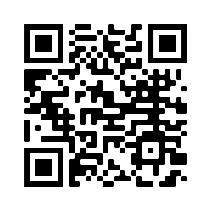
Surface Survival
Based on a lab study
  In the air 3 hours
  Copper 4 hours
  Cardboard 24 hours
  Stainless Steel 48 hours
  Plastics 72 hours
N. van Doremalen et al. Aerosol and Surface Stability of SARS-CoV-2 as Compared with SARS-CoV-1, New England Journal of Medicine.
https://www.nejm.org/doi/full/10.1056/NEJMc2004973

Slide 11

Inactivation with Disinfectants
Ethanol (62%-71%) 99% to 99.99%
Hydrogen Peroxide (0.5%) 99.99%
Bleach (0.1%) 99.9%+
G. Kampf et al. Persistence of coronaviruses on inanimate surfaces and their inactivation with biocidal agents
https://www.journalofhospitalinfection.com/article/S0195-6701(20)30046-3/fulltext

Slide 12
SARS-CoV-2 is Not Likely Foodborne
CDC, FDA and European Health Agencies all report that there is currently no evidence to support that food or food packaging materials being associated with transmission of SARS-CoV-2
Currently there is no evidence of food or food packaging being associated with transmission of COVID-19.
Unlike foodborne gastrointestinal (GI) viruses like norovirus and hepatitis A that often make people ill through contaminated food, SARS-CoV-2, which causes COVID-19, is a virus that causes respiratory illness. Foodborne exposure to this virus is not known to be a route of transmission.

Slide 13
Determining a Reputable Information Source
Michelle Jacokes
April 8, 2020

Slide 14

Determining a Reputable Source
Michelle Jacokes
Manistee Conservation District
Northwest Lower MI Produce Safety Technician
Is a source credible?
the likelihood that something informs- or, at least avoids misleading
Is the source informative?
  to form accurate beliefs which can be used to make decisions
Credibility
likelihood that something enables a person to form accurate beliefs and use them to make effective decisions, especially ones relevant to their lives- or at lease avoids decreasing the accuracy of someone's beliefs or the efficacy of their decisions
  OR
  Information is high quality and trustworthy- we can believe that it is true!
Notes:
Sources:
TOW Center for Digital Journalism University of Columbia
https://www.cjr.org/tow_center_reports/ovadya-credibility-journalism-ocasio.php

Slide 15

Navigating a Credible/Reputable Source
FACTORS TO CONSIDER:
  Authors expertise
    Author credentials
  Publisher
    Origin of the document or information
  Accuracy and Objectivity
    Can the facts presented be found elsewhere?
    Point of View
      Potential bias
      Being able to see all sides of the issue or information
  Peer Review
  Date of Publication or Timeliness
    When was it created or is it current
    Has it been updated?
  Footnotes or Bibliographies
    Legitimate references and links to other sources can add credibility and depth
  Sponsorship
    Is the information linked to a parent organization and is it supported by that organization
  Appropriateness of What You Are Looking Into
Notes:
https://library.columbia.edu/libraries/undergraduate/evaluating_web.html
https://www.library.georgetown.edu/tutorials/research-guides/evaluating-internet-content

Slide 16
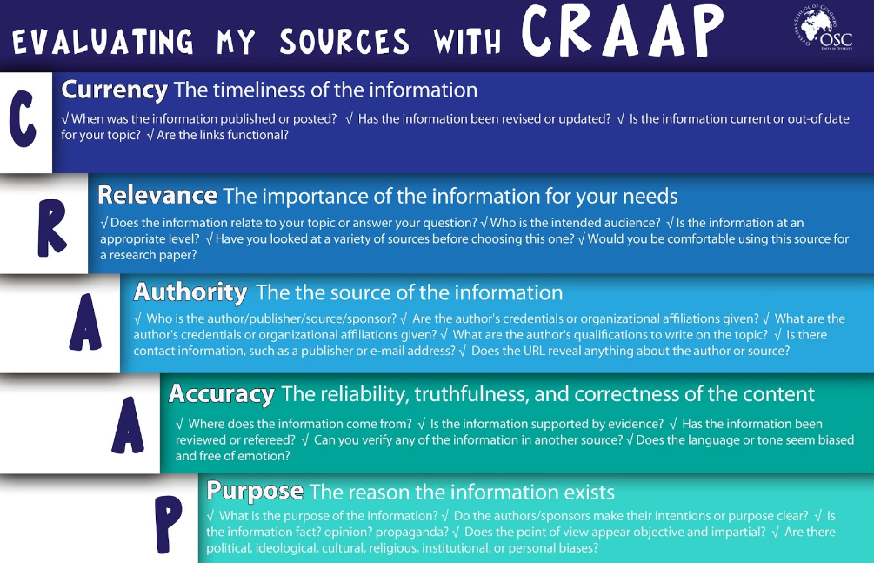
Use the CRAAP test:
Notes:
You know we love to talk about poo in food safety but here is a way to evaluate a credible resource,
https://libguides.rowan.edu/c.php?g=329927&p=2215288

Slide 17
Questionable Sources
If you feel that information may be bias or opinion based, make sure to fact check and cross reference for accurate information
SOURCES THAT MAY MISLEAD:
Social Media
Personal Blogs
Uncited Materials
News (some)
Wikipedia
Out-of-Date Materials
Word of Mouth
Non-Scholarly Sources (ideas not necessarily based off research)
Notes:
WHO Mythbusters: https://www.who.int/emergencies/diseases/novel-coronavirus-2019/advice-for-public/myth-busters
https://www.cabarrus.k12.nc.us/site/handlers/filedownload.ashx?moduleinstanceid=36124&dataid=221898&FileName=Credible%20v%20Non-Credible%20Sources13.pdf

Slide 18
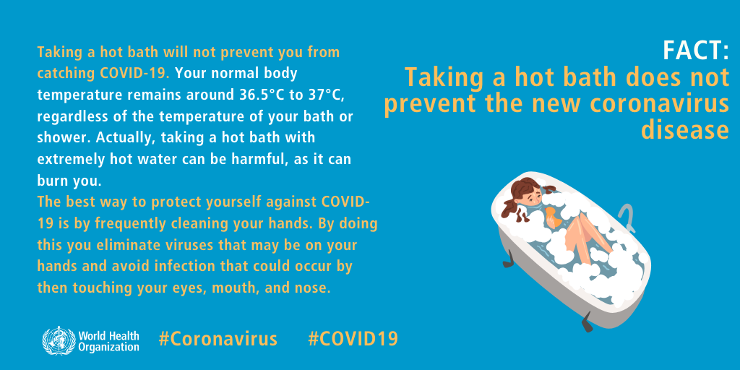
Questionable Sources: Fight Misinformation
Consider the source, and the sources source
Check your own biases
Is the information constructive?
Be empathetic- the goal is not to be right, but to be helpful
Don’t spread panic, spread the facts
Notes:
We have never in the history of a pandemic had this sort of information climate
https://www.theatlantic.com/ideas/archive/2020/03/heres-how-fight-coronavirus-misinformation/608914/

Slide 19
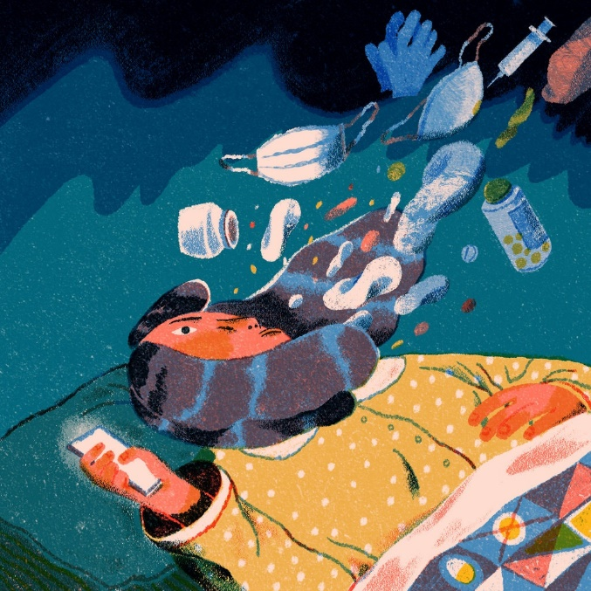
Examples of Reputable Sources for COVID-19
PRIMARY SOURCES:
Center for Disease Control (CDC)
World Health Organization (WHO)
Relevant Medical Professionals/Researchers or other Public Health Organizations
Various University or University Extension Organizations
  i.e. MSU Extension
*Additional reputable resources pertaining to farming
and food systems will be shared following this webinar
Notes:
Note that we have increased accessibility to information from our phones, and information is easily accessible but not always true!
Secondary Sources:
News
Specialists in Food Industry able to interpret info to make relevant

Slide 20
Cleaning, Sanitizing and Disinfecting
Jae Gerhart
April 8, 2020

Slide 21
Cleaning v. Sanitizing v. Disinfecting
CLEANING | SANITIZING | DISINFECTING
All surfaces | Food-contact surfaces | Non-food contact surfaces
Physical removal of soil and residue | Treatment to reduce number of micro-organisms | Treatment to destroy or inactivate infectious organisms
Detergent | Sanitizer | Disinfectant
Credit: NC State Extension

Slide 22
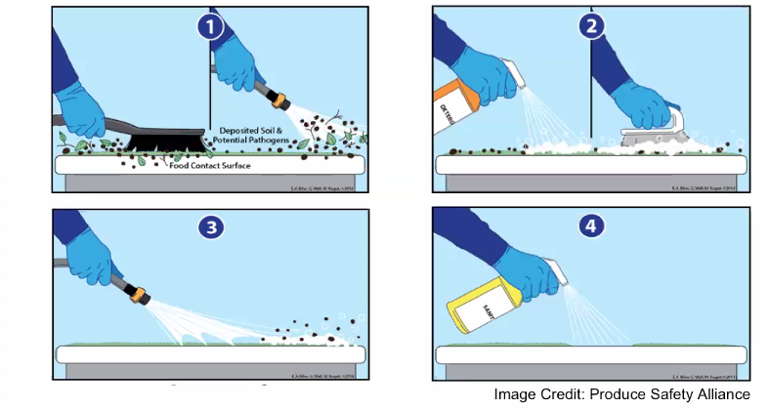
Basic Steps for Cleaning and Sanitizing

Slide 23
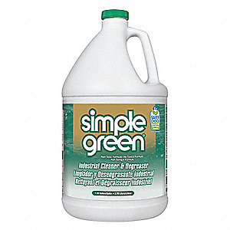
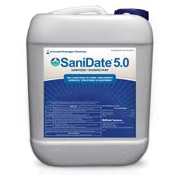
Detergents v. Sanitizers
Detergents
  Not EPA-regulated
  Helps clean off the dirt
  Bubble help inactivate envelope-viruses
  Examples – Simple Green, Greenclean, CS 223
Sanitizers
  EPA-registered – look for “food contact surfaces”
  Cannot have artificial scents or perfumes
  Tested for bacterial pathogens
  Examples – germicidal bleach, Sanidate

Slide 24

Key Factors when Sanitizing
Surface must be clean before sanitizing
Follow the concentration levels
Ex. 1 TBS reg bleach / gallon
Concentration + time = effectiveness rate
Use cleaning tools dedicated for food contact surfaces
Do not mix with disinfectants

Slide 25
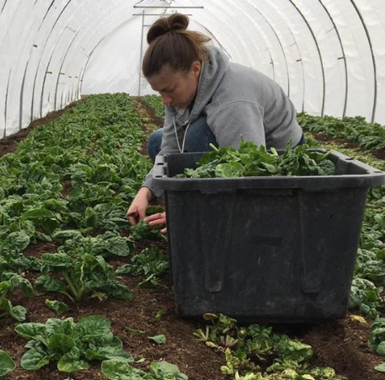

Identify food contact surfaces v. non-food contact surfaces
Credit: Green Things Farm Collective

Slide 26
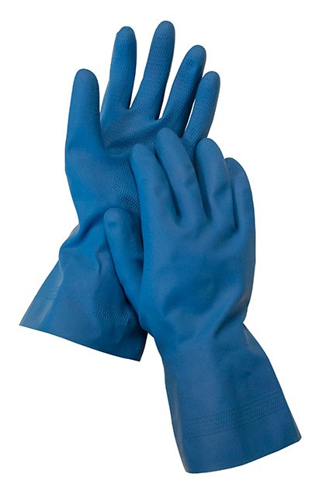
Disinfecting High-Touch Surfaces
Doorknobs, touchscreens, bathrooms, eating facilities, handwashing facilities
Higher concentration
  Bleach: 5 TBL per gallon or 4 tsp per quart
Wear proper PPE
Can use disinfecting wipes:
  Follow label directions
  May need to use more than one wipe for cleaning
Frequency: often

Slide 27
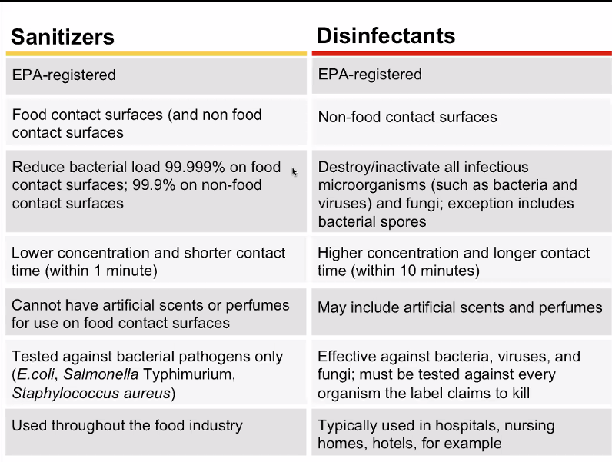
Sanitizers v. Disinfectants
Credit: NC State Extension

Slide 28
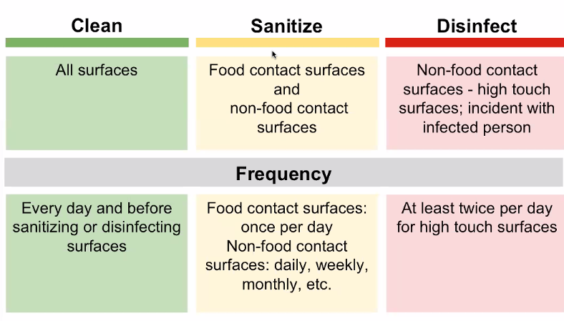
Frequency
Credit: NC State Extension

Slide 29
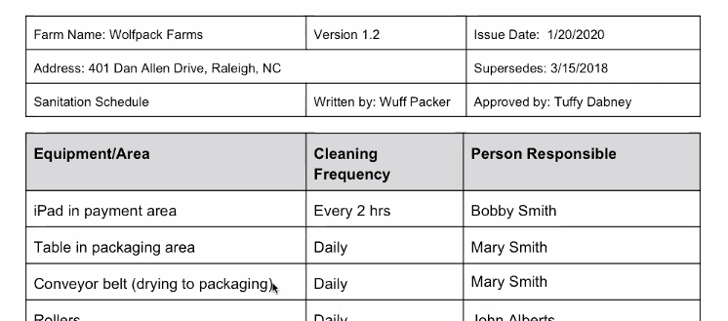
How to Apply on Your Farm
Develop a Sanitation/Disinfection Schedule
  List of equipment/tools that need to be cleaned
  Include frequency of cleaning
  Train employees and develop SOPs
  List type of cleaning required
  Assign employees to certain cleaning tasks

Slide 30
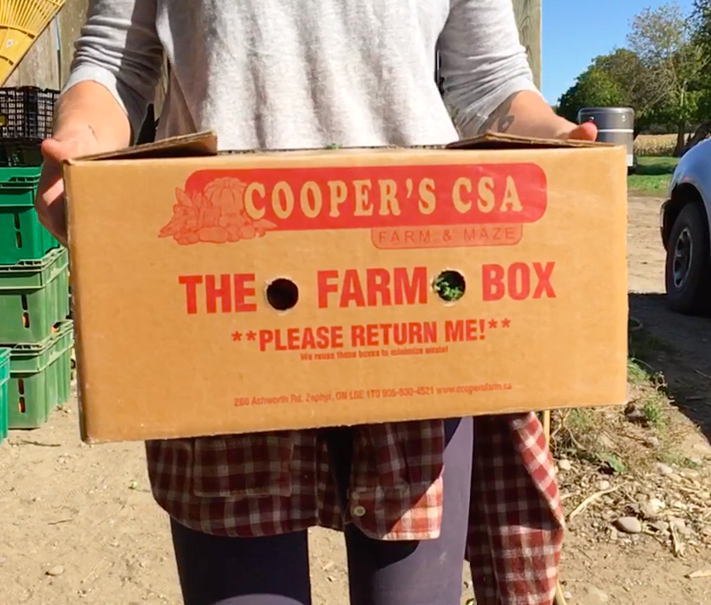
Additional Considerations
Use only NEW or clean packaging
Do not accept cardboard or any other packaging from customers

Slide 31
Tips & Best Practices
From a Fellow Grower
Rebecca Henderson
CSA & Wholesale Manager
Green Wagon Farm

Slide 32
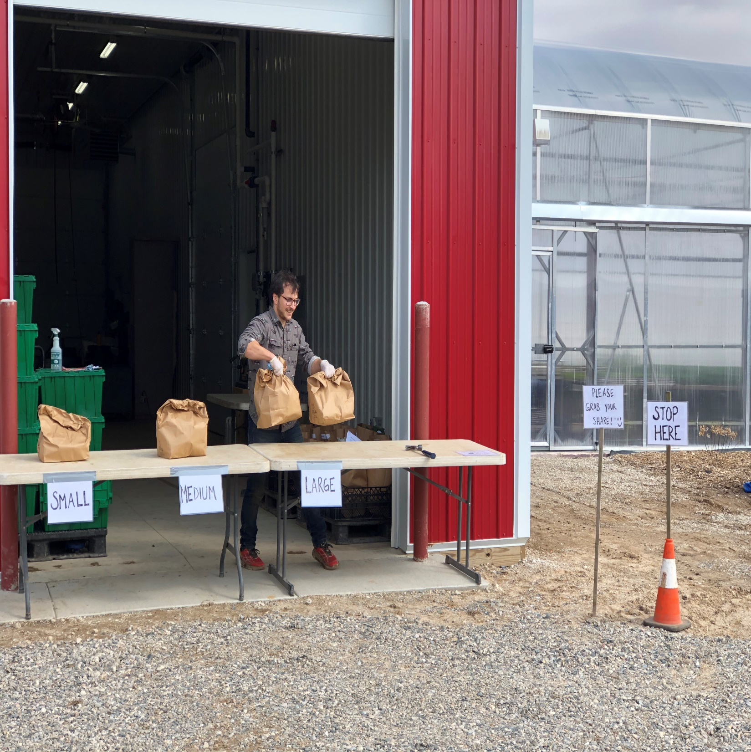

Slide 33
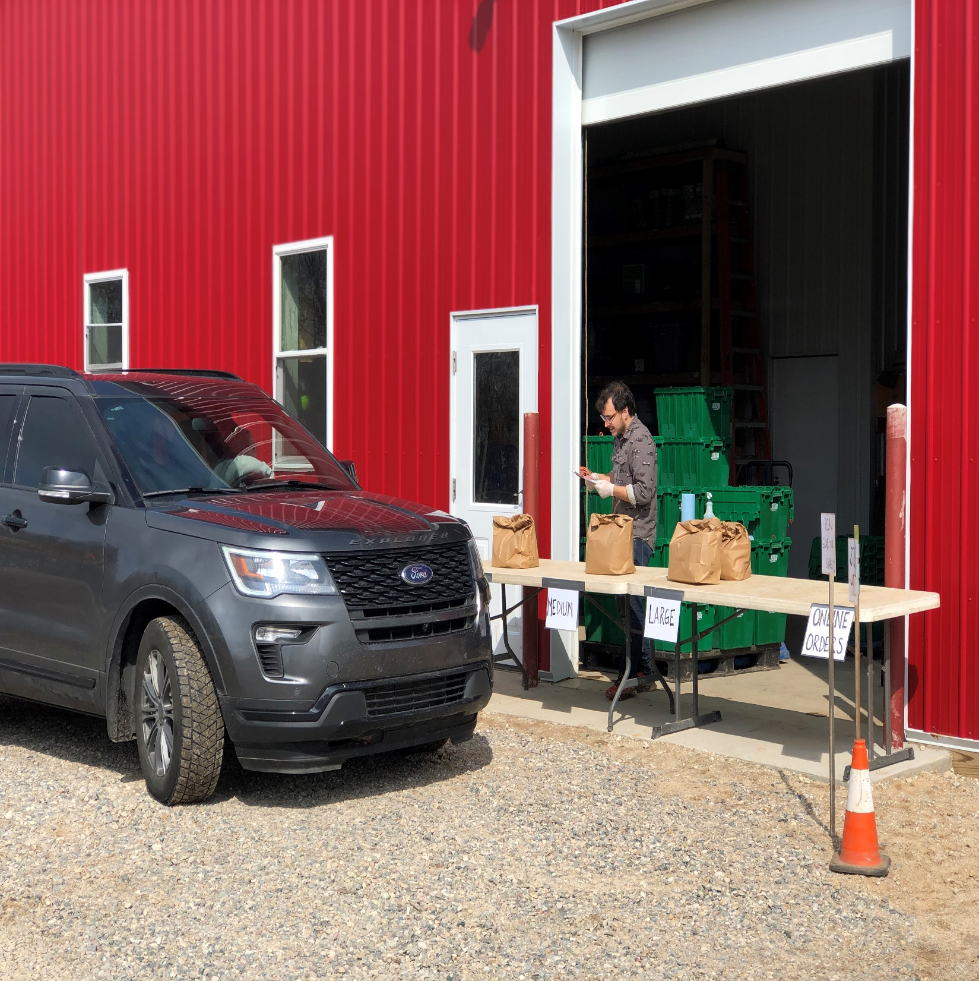

Slide 34
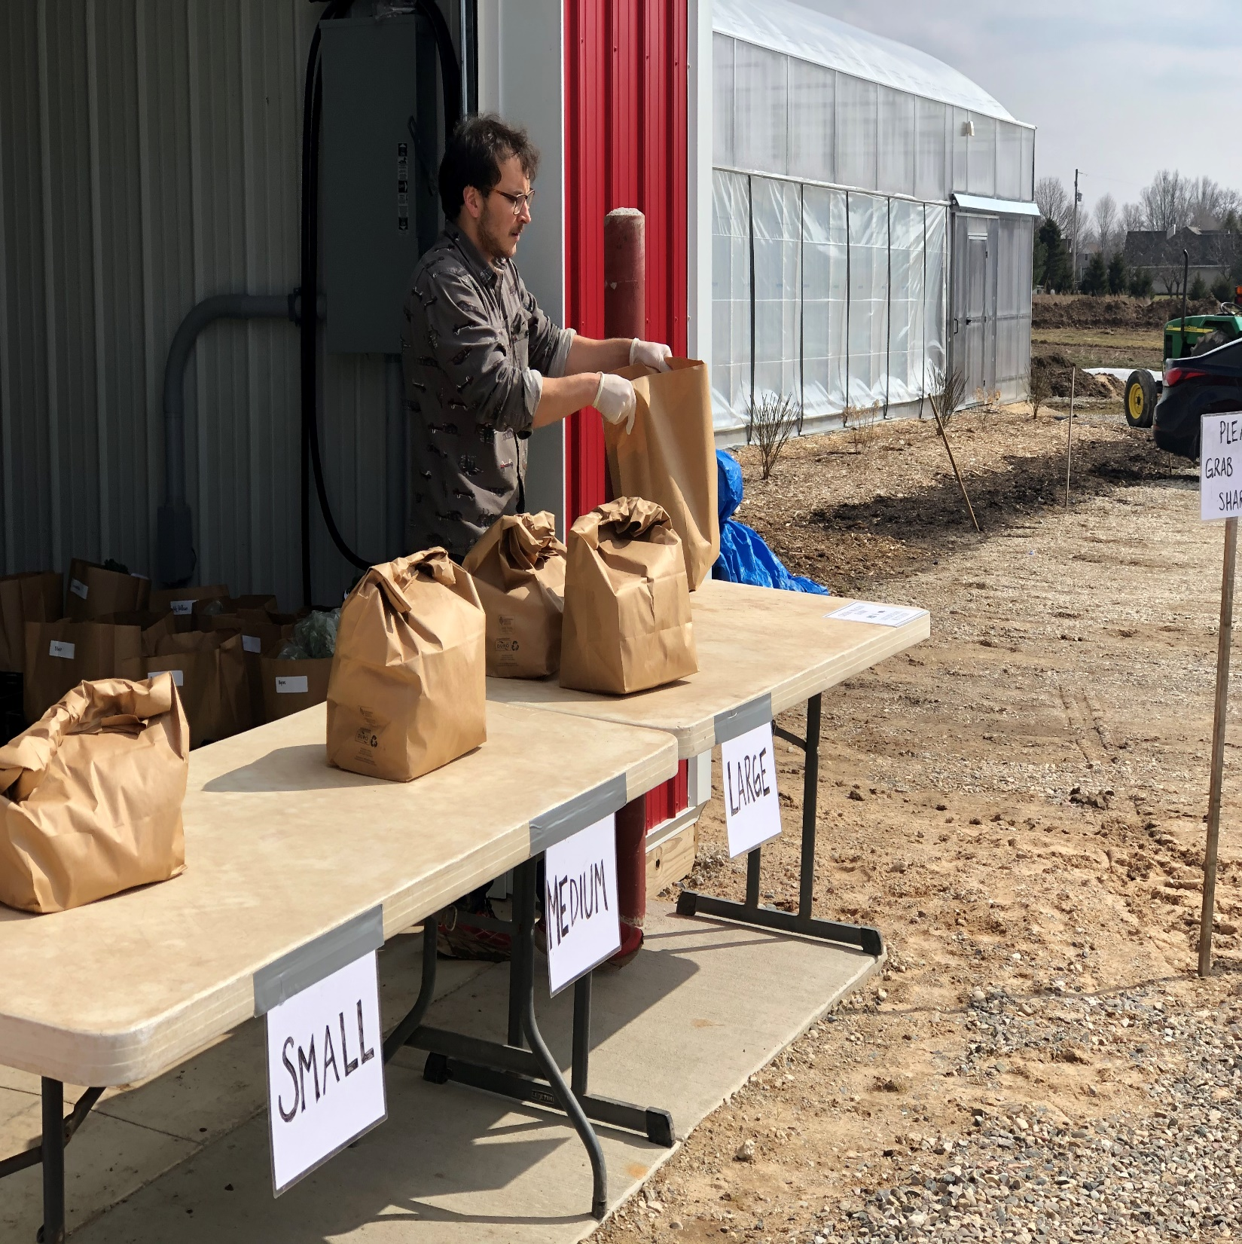

Slide 35
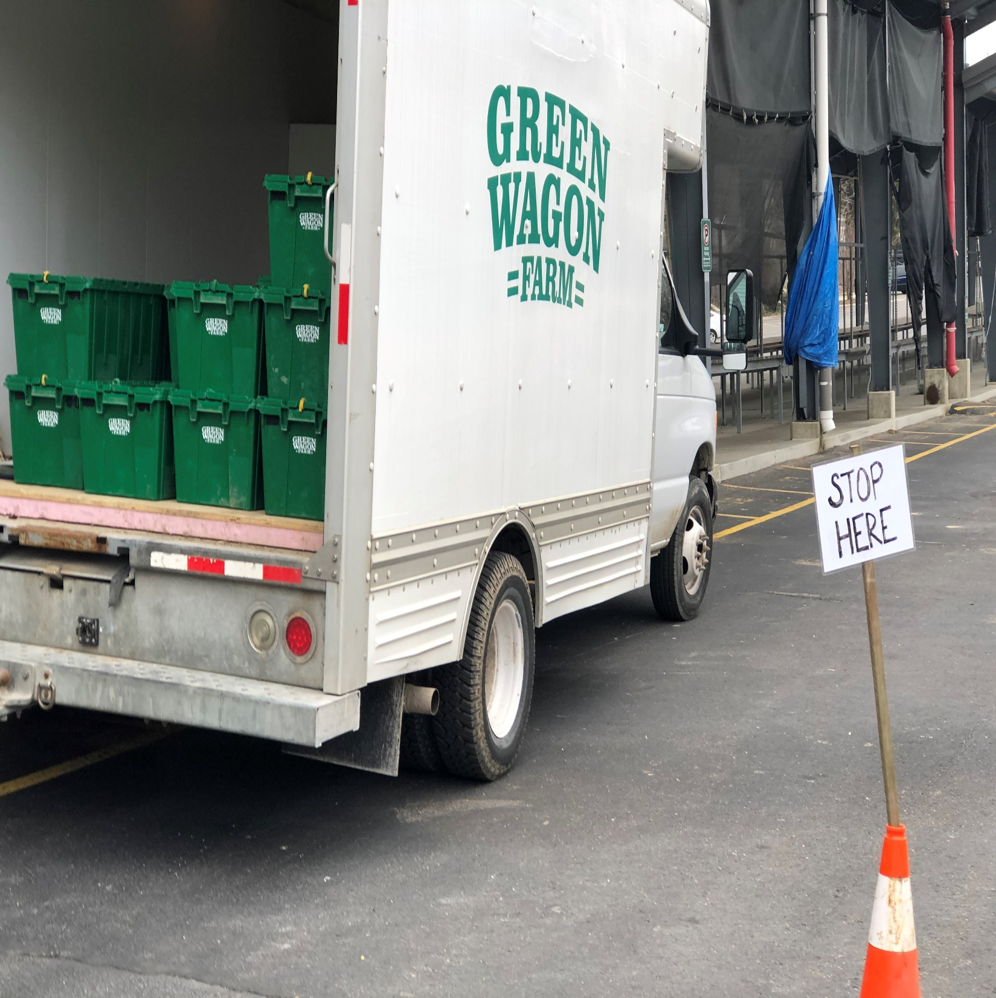

Slide 36
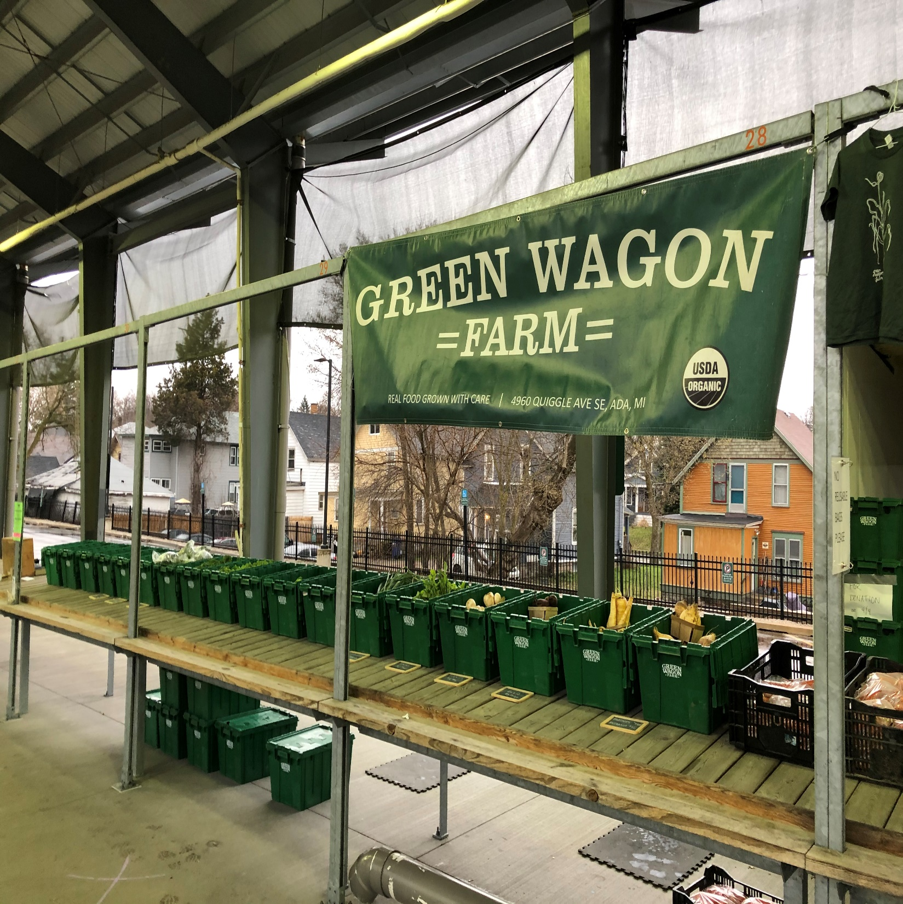

Slide 37
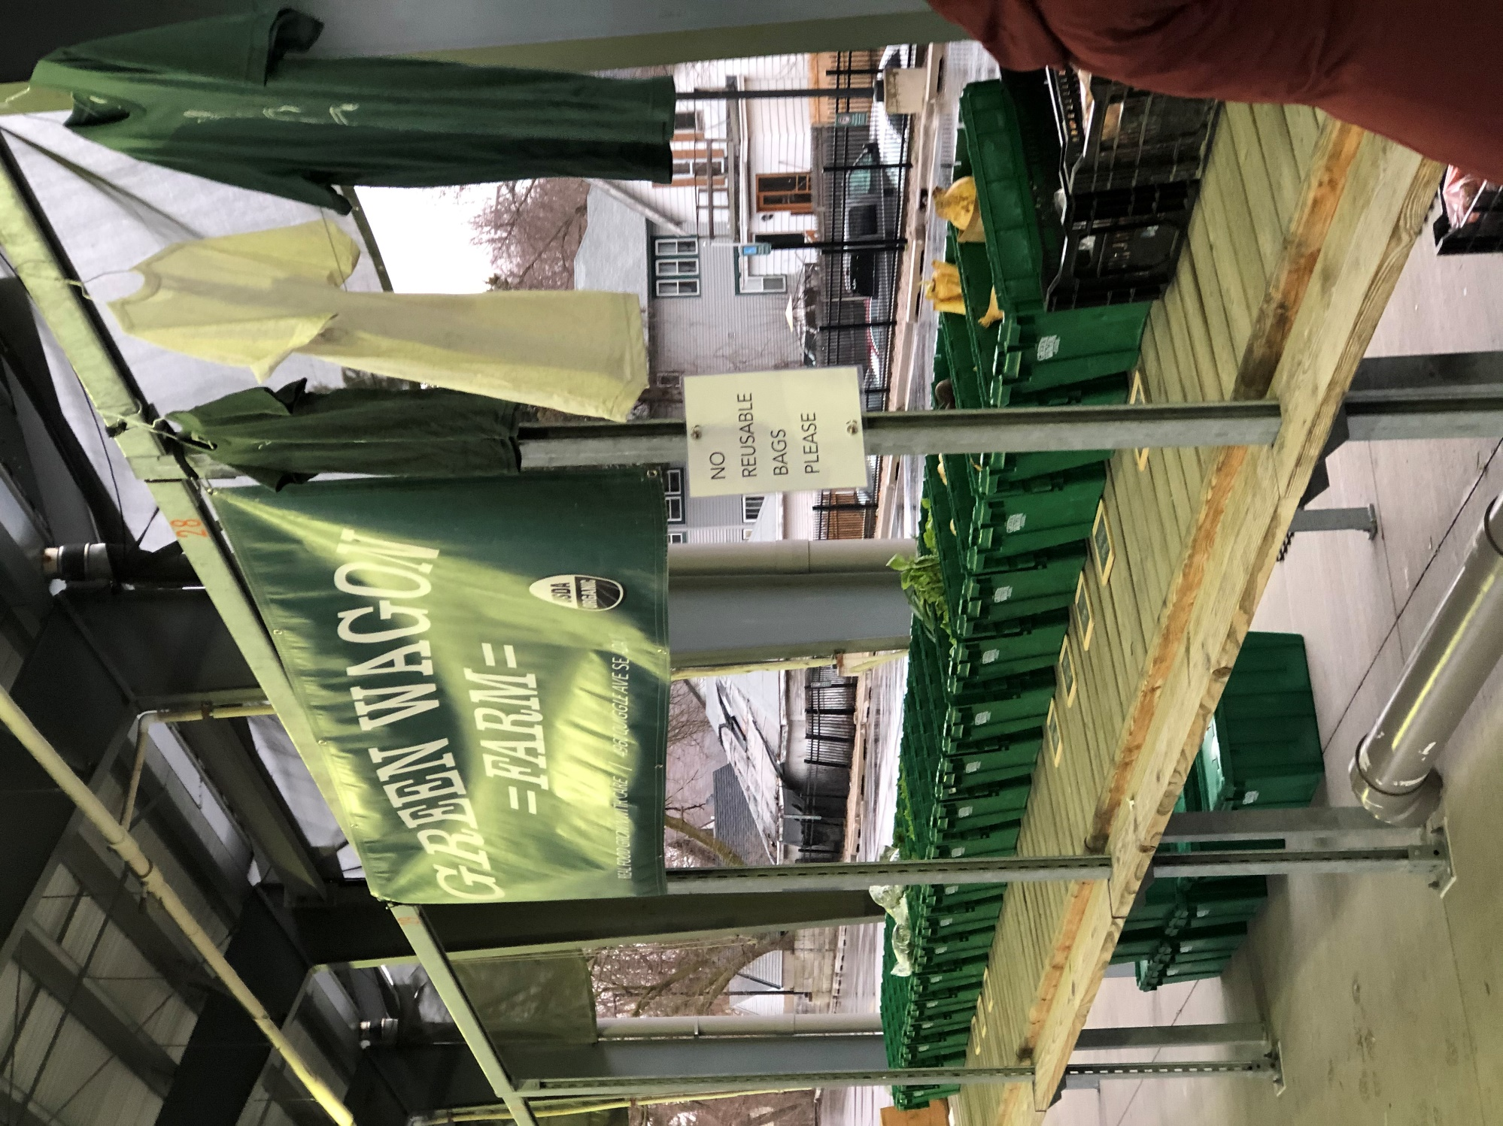

Slide 38


Slide 39
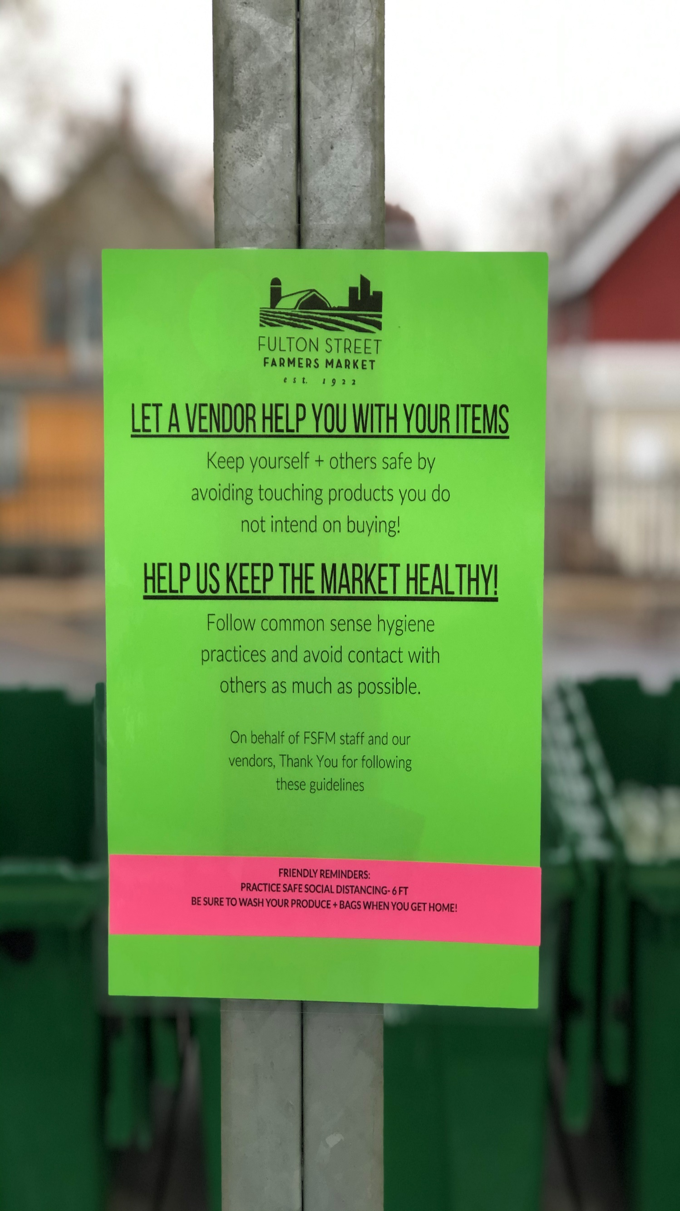

Slide 40
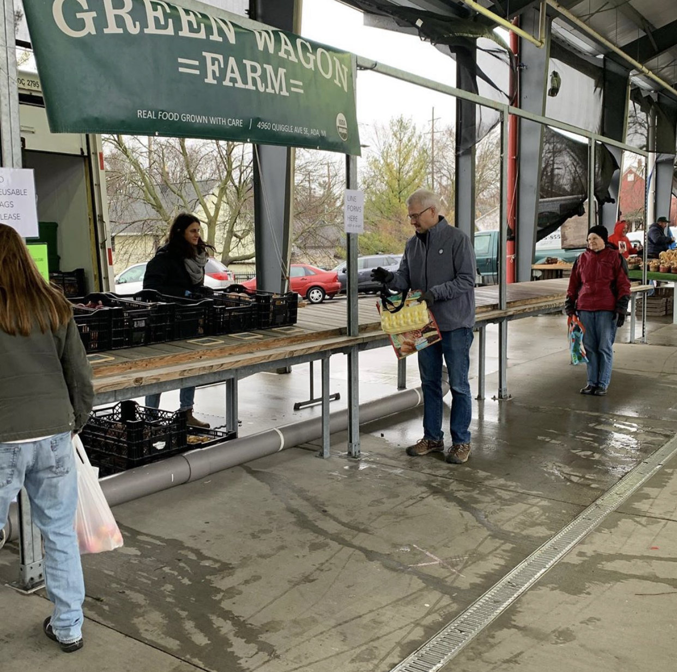

Slide 41
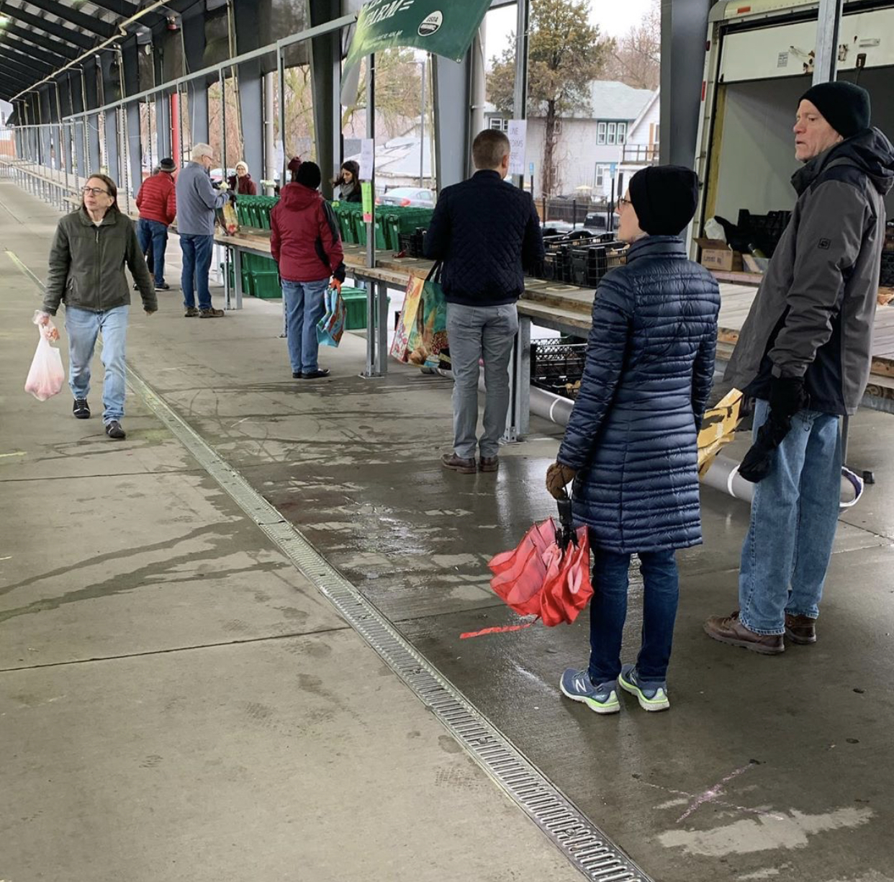

Slide 42
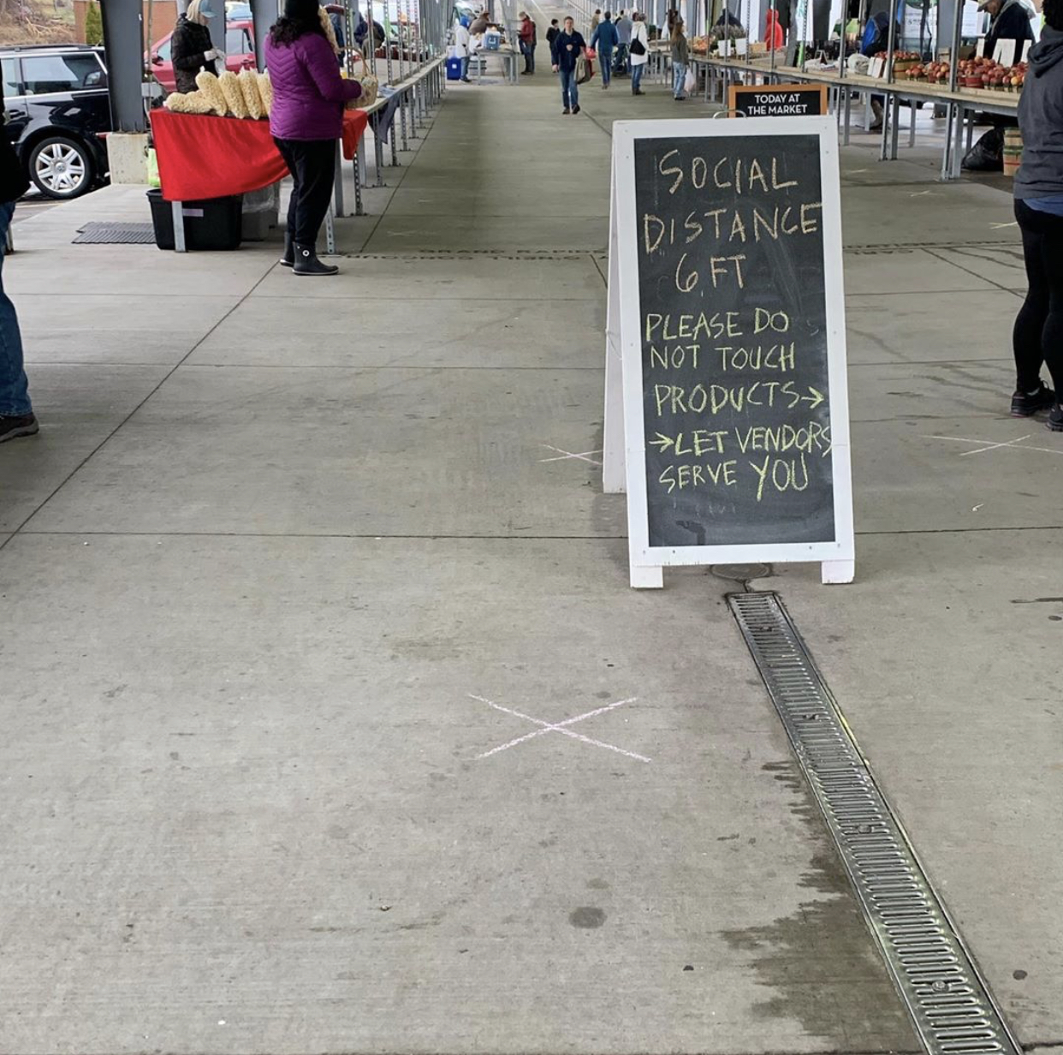

Slide 43
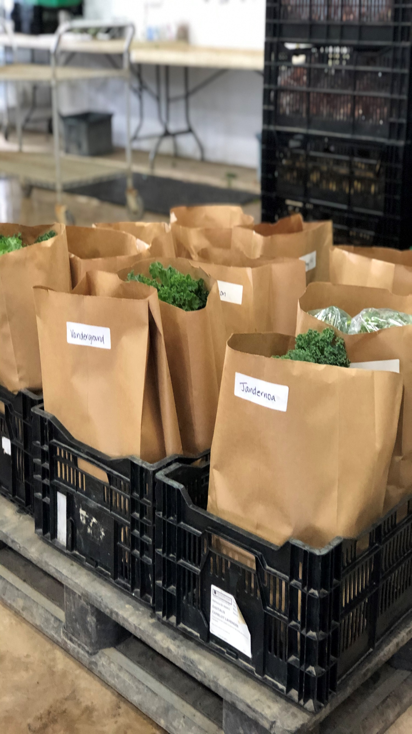

Slide 44
Other Tips & Best Practices
From a Fellow Grower
Rebecca Henderson
CSA & Wholesale Manager
Green Wagon Farm

Slide 45
Employee Health and Hygiene
Jordan Devries
April 8, 2020

Slide 46

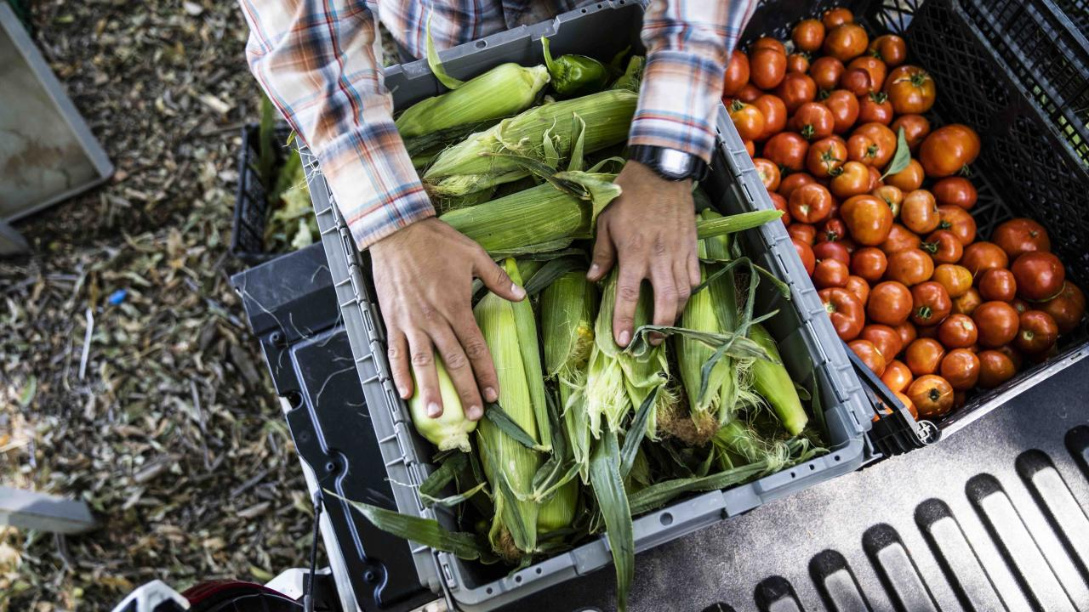
Farmworker health and respiratory illness
Building on the foundation of Good Agricultural Practices (GAPs) and the Produce Safety Rule (PSR)
Jordan DeVries,
Produce Safety Technician. Newaygo Conservation District
.
Many worker health and hygiene practices adopted from the Produce Safety Alliance grower training manual and GAP audit preparation manuals conveniently apply to respiratory illnesses.
This situation will test health and hygiene training and standards at many produce farms and require a doubling-down of worker practice monitoring by farm managers followed by in season re-training.
Adding social distancing to the produce farm daily routine while maintaining harvest schedules, food safety program standards and minimizing labor costs will require a dedication to a culture of worker health and safety across all farm levels –imprinting is key.
Photo: UC Davis Agricultural Sustainability Institute
Photo: theengingeringmindset.com
Notes:
Unlike persons infected with foodborne illness microorganisms, the respiratory-transmitted viruses can have silent carriers that can last days weeks even in-perpetuity without having symptoms (fever, dry cough, difficulty breathing, loss of taste or smell).
With the exception of new social distancing and face mask wearing guidance, the tried-and-true practices of good handwashing hygiene and farmworker health assessments are solutions that produce farmers should have already implemented to control foodborne microorganisms of concern.

Slide 47
Worker training consistency with GAPs and PSR
Practice Training | Produce Safety Rule | Good agricultural practice | CDC Guidance
Handwashing 20 seconds | very important | very important | very important
Hand sanitizer use | Not important | Somewhat important | Somewhat important
Face mask or covering | Not important | Important for facial hair | Very important
Diarrhea, vomiting, fever nausea, or jaundice daily health monitoring review | Very important | Very important | Very important for fever, somewhat for diarrhea and nausea
Coughing into elbow, tissue | Somewhat important | Somewhat important | Very important
Clean tools & equipment | Very important | Somewhat important | Not important
*Sanitized tools & equipment | Very important –if possible contamination occurred | Somewhat important | Very important –if shared by workers
Sanitation of food contact surfaces | Very important | Very important | Not important
Sanitation of worker contact surfaces | Somewhat important | Somewhat important | Very important
Social distancing | Not important | Not important | Very important
Notes:
Provide Training to everyone who works at the Farm (employees, volunteers, family members, etc.) regarding symptom recognition. (Chris Gunter, NC State Always Be Cleaning webinar 4/3/2020))
*

Slide 48
Social distancing: Mandated in Executive Order 2020-21
Businesses and operations maintaining in-person activities must adopt social distancing practices and other mitigation measures to protect workers and patrons. Those practices and measures include, but are not limited to:
Restricting the number of workers present on premises to no more than is strictly necessary to perform the business’s or operation’s critical infrastructure functions.
Promoting remote work to the fullest extent possible.
Keeping workers and patrons who are on premises at least six feet from one another to the maximum extent possible, including for customers who are standing in line.
Increasing standards of facility cleaning and disinfection to limit worker and patron exposure, as well as adopting protocols to clean and disinfect in the event of a positive COVID-19 case in the workplace.
Adopting policies to prevent workers from entering the premises if they display respiratory symptoms or have had contact with a person who is known or suspected to have a respiratory infection.
Any other social distancing practices and mitigation measures recommended by the Centers for Disease Control.
Notes:
Prepare your disaster contingency plan. What will you do if 50% of your employees become sick and unable to work? Are there neighboring farms who might be able to share resources in an emergency? Who will manage for a few weeks if you or another key manager are unable to leave your house or are hospitalized?

Slide 49
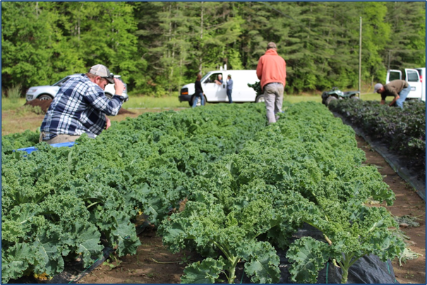
Farmworker social distancing best practices
At the farm or workplace
Maintain harvest ‘lanes’ for individual workers. Split crews into subunits made up of workers from same household or carpooling group.
Consider maintaining 6ft. distance on bus transportation to farm and to harvest fields.
Stagger breaks to limit number of people in lunchrooms and water cooler and restroom lines.
Reduce potential for interaction with visitors; visitors shouldn’t be using farmworker’s facilities.
Develop harvest or packing facility plans for reduced worker density. Ex. adding new shifts, or second packing lines in alternative areas.
Photo: NC State Univ.
Notes:
Minimize face-to-face meetings to only what is business critical •Adopt remote staff meetings, using telephone and web conferencing (zoom) •Identify critical activities; Minimize work shift overlaps Develop SOPs to ensure social distancing whenever possible •Use remote communication options including texting platforms; explore options. Put more effort into preharvest scouting to focus first-pass harvest efforts on mature rows, allowing a small harvest crew to maximize labor efficiency and maintain workflow. Consider secondary markets for repeat harvest passes, where quality isn’t as important.

Slide 50
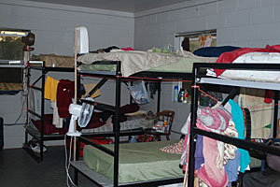
Farmworker social distancing best practices
At home or within migrant camps
Discourage group social engagements. Explain flattening the curve to the best of your abilities.
Consider paying for cell phone data or home Wi-fi to encourage social distancing. $30-70/mo. Vs. cost of new worker training or unharvested crop losses.
Offer to shop for workers or designate select workers to do shopping who understand risks and are good at practicing social distancing.
Discuss plans for self quarantining and home isolation openly; let workers be part of the process. Address home isolation capability by evaluating alternative housing for symptomatic workers.
Photo: National Institute of Health
Notes:
Importance of positive reinforcement: describe what you and your neighbors have been doing. Ask farmworkers what their reading list may be; provide books, newspapers, card games.

Slide 51
Employee health monitoring
Responsibility of farm owner/manager
  Farmworkers may not wish to share this information, but farms are entitled to ask questions regarding symptoms of respiratory illness.
  Monitor for cough, shortness of breath, fever (elevated temperature easiest to monitor- often accompanied by chills/body aches/confusion)
  Equal Employment Opportunity Center and Americans with Disabilities act both changed to temporarily not prohibit infrared temperature monitoring.
  Will employees feel financially or otherwise obligated to come to work even if they are sick?
In the event that anyone working at the farm tests positive for respiratory illness, follow State of Michigan essential employees rules:
At least 3 days (72 hours) have passed since symptoms have resolved without the use of fever-reducing medications, and improvement in respiratory symptoms (e.g., cough, shortness of breath, and
At least 7 days have passed since symptoms first appeared, or since the first positive COVID-19 test, if tested
Provide cleaning solutions, rags, mops, buckets and create SOPs for home-isolating sanitation.
Make sure they have enough food and water as they will not be able to go to the store and may not have any funds to buy their own.
Notes:
Employees who have symptoms (i.e., fever, cough, or shortness of breath) should notify their supervisor and stay home.
Make sure the sick person drinks a lot of fluids to stay hydrated and rests at home. Supply over-the-counter medicines that may help with symptoms.
Employees should not return to work until the criteria to discontinue home isolation are met, in consultation with healthcare providers and state and local health departments. If they will be tested to determine if they are still contagious, they can leave home after these three things have happened: They no longer have a fever (without the use medicine that reduces fevers) AND other symptoms have improved (for example, when their cough or shortness of breath have improved) AND They received two negative tests in a row, 24 hours apart.
Employees who are well but who have a sick family member at home with COVID-19 should notify their supervisor and follow CDC recommended precautions: In Michigan returning to work with a known case at home is a violation of Governor Whitmer’s Executive Order 2020-21.
Monitor for worsening symptoms. About 20 percent of infected people will need hospitalization. If self isolating employees or their family members develop emergency warning signs they should get medical attention immediately. Emergency warning signs include*:
Trouble breathing Persistent pain or pressure in the chest New confusion or inability to arouse Bluish lips or face.
The USCIS provided a statement that says, “USCIS encourages all those, including aliens, with symptoms that resemble Coronavirus Disease 2019 (COVID-19) (fever, cough, shortness of breath) to seek necessary medical treatment or preventive services. Such treatment or preventive services will not negatively affect any alien as part of a future Public Charge analysis.” _Farmworker Clinician Services
.

Slide 52
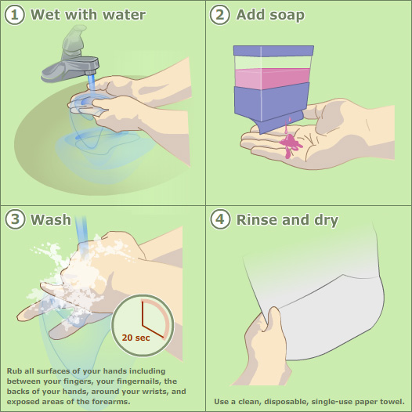
Handwashing Hygiene
Ensure that workers are provided with clean water (no detectable E. coli in annual sample) working soap dispensers, clean dry single-use towels and empty trash. Monitor water/supplies in Porta-Johns.
+60% alcohol hand sanitizers are considered effective for hand sanitation; they are not a replacement for handwashing for parasites, bacteria, or viruses that cause known produce contamination outbreaks. Produce Safety Alliance: Provide hand sanitizer and encourage frequent use.
PMA: Provide fully functional handwashing facilities, keep records of monitoring.
Notes:
Handwashing should be done for a minimum of 20 seconds (PMA recommends 30 seconds) with soap and water, front and back of hands, paying extra attention to space between fingers and nail areas. Extra hand washing sinks or portable handwashing units are important for increasing compliance, along with demonstrations and imprinting.
An overlooked part of handwashing hygiene is conducting a risk assessment for knowing when to wash hands. Produce Marketing Association Draft fieldworker guidance: Wash hands after each instance of coughing into a tissue or using a tissue or cloth to wipe face.
Farmworkers can imagine in their minds a virus, bacteria or parasite source they might have encountered, even if they can’t see the pathogen of concern. Just like dirt should be washed off hands before handling produce due to its high microbial risk, if workers have touched door knobs, shared tools or other’s hands they should wash their hands prior to eating or touching eyes, nose mouth or adjusting face masks

Slide 53
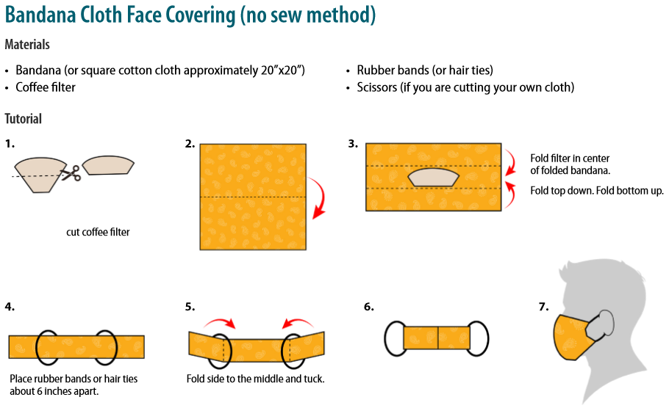
Mask and face covering hygiene
face covering is not a replacement for social distancing measures
CDC guidance: cloth face coverings should—
fit snugly but comfortably against the side of the face
be secured with ties or ear loops
include multiple layers of fabric
allow for breathing without restriction
be able to be laundered and machine dried without damage or change to shape
https://www.cdc.gov/coronavirus/2019-ncov/prevent-getting-sick/diy-cloth-face-coverings.html
Notes:
A cloth face covering should be worn whenever people are in a community setting, especially in situations where you may be near people. These face coverings are not a substitute for social distancing. Cloth face coverings are especially important to wear in public in areas of widespread illness. Wearing cloth face coverings is an additional public health measure people should take to reduce the spread of virus. CDC still recommends that you stay at least 6 feet away from other people (social distancing), frequent hand cleaning and other everyday preventive actions. A cloth face covering is not intended to protect the wearer, but it may prevent the spread of virus from the wearer to others. This would be especially important if someone is infected but does not have symptoms.

Slide 54
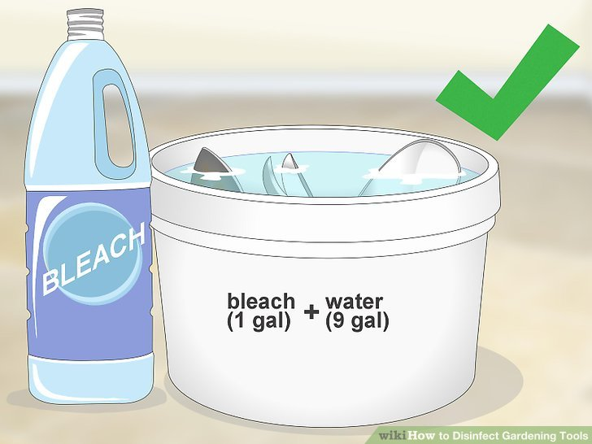
Phone, tool and equipment hygiene
Produce Marketing Agreement Draft guidance: leave phones with personal belongings and check them only during breaks, phones must be sanitized before and after use. Do not share phones.
Shared tools or harvesting equipment should be cleaned between uses by a different employee.
Tools and equipment must be cleaned and sanitized before each shift, frequently throughout the day, and at the end of the shift.
Photo: Wikihow (note: 1/3 cup bleach per gal. water recommended by CDC and FDA)

Slide 55
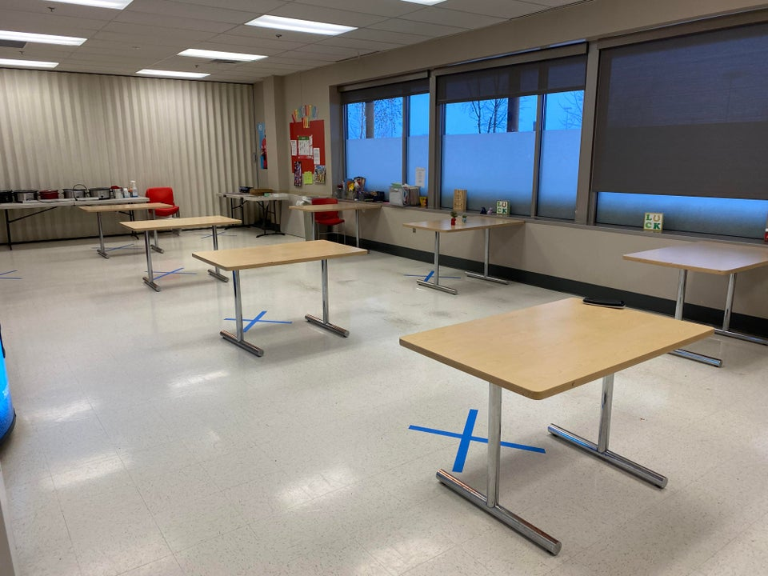
Food and water break hygiene
Prioritize cleaning and sanitizing high traffic areas, commonly touched surfaces.
Workers should be seated separately.
Breaks can be opportunities to monitor farmworkers for signs of illness.
Water stations should be made operable without using hands to open valve.
Water cups should be single use, trash cans should be made available.
Executive order requirement to maintain 6ft social distancing applies.
Notes:
Ex. High traffic, commonly touched: bathroom door handles and water dispenser valves
Other symptoms to monitor: lack of thirst or appetite, complaints of fever, chills or aches.
Wrist bars, knee bars and foot pedals are useful modifications for hands free water dispensers
Unmarked clear plastic reusable water bottles should be discouraged.

Slide 56
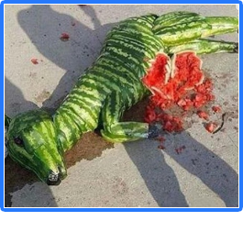
Creating a culture of respiratory infection readiness
Why your farm is increasing its emphasis on hygiene practices, stepping up health monitoring routines and implementing face covering is key to their adoption.
Public health practices are only as strong as their weakest link.
A critical loss of farm workers can affect produce grower’s financial future and decisions on whether to harvest a crop, resulting in walk-by food waste.
Loss of even a minimal amount of farm workers can make it harder to meet pack-out quality standards, stay on harvest schedule or conduct food safety monitoring.
Plan for continuity of operations with cross training, crop planning, providing supplies and active communication
Don’t get caught flat-footed
Notes:
Workers should feel empowered to be part of the solution, including decision making processes that affect their health and well being. Voluntary health disclosures and opportunities for medical caregiver virtual assessments should be encouraged.
Imprinting and positive reinforcement are some of the most important nonverbal communication tools that growers have

Slide 57
Chat Box is Open
To receive a follow up email from a local resource person
In the Chat Box, enter:
Name
Email address
County and State of Residence
Notes:
Those who phoned in can email this information and any other questions they have to: gaps@msu.edu

Slide 58
Thank you for Joining Us!

